Slide 1
Instruction on Exam question submission
--imaging, ECG & data interpretation
Date

Slide 2
Examination candidate Instructions
This is a non-interactive station.
Read the station materials carefully and interpret the imaging and data provided
Write your answers on the answer sheets provided.
Short answers and bullet points are preferred.
You have 10 minutes for each station (40 minutes total).
Begin immediately.

Slide 3
Generic template
(Scenario/information/ background of the question)
Image / ECG / video clips / lab data
a. (Question no) (X mark)

Slide 4
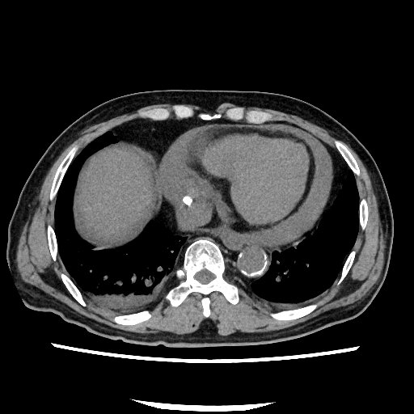
Sample question 1--Image
A 65 yo ESRF patient with history of aortic valve replacement underwent a hemocatheter insertion from the internal jugular vein. After that, he developed with hypotension and chest discomfort.
An urgent CT thorax was performed.
a. What is the diagnosis? (1 mark)

Slide 5
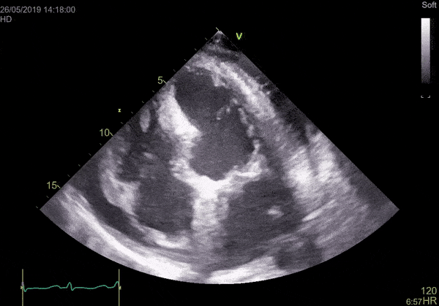
Sample question 2-- Video Clips
The patient was resuscitated with intravenous fluids and systolic BP back to 105 mmHg. Urgent bedside echocardiography was performed.
b. Does the patient have cardiac tamponade? Why? (2 marks)

Slide 6
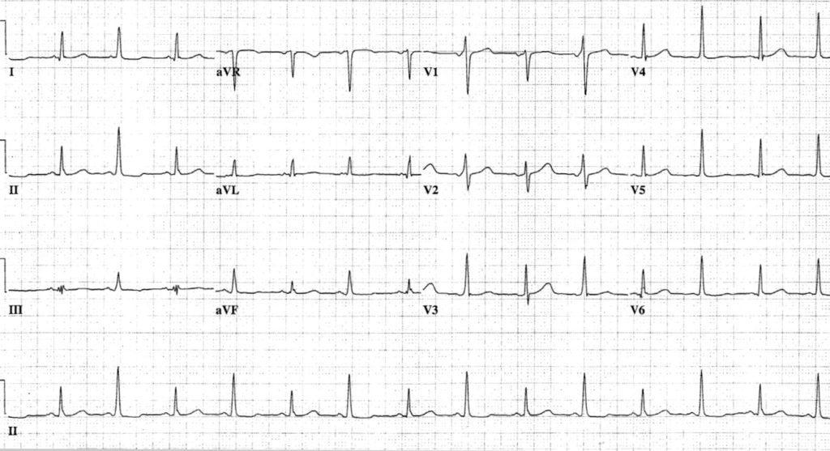
Sample question 3-- ECG
6 hours later, the patient had recurrent hypotension and chest pain. ECG was immediately performed. c. Please comment on the ECG. What is it suggestive of? (1 mark)

Slide 7
Sample question 3-- ECG d. What will be your immediate management. List three. (1.5 marks)

Slide 8
Sample question 4– lab data Interpretation
A 76 yrs old man couldn’t be contacted by son for 2 days, found decrease in GC at home and sent to hospital by son.
Parameter | Patient value | Normal range
Sodium | 120 | 135-145 mmol/L
Potassium | 4.5
Urea | 10
Cr | 110
Glucose | 68
xxx | xxx
What is the adjusted serum sodium? (1mark)

