Slide 1
If a patient with a Medical Disease was admitted to a Surgical Ward..
Ngai Chun Wai Wallace
AICU
Queen Mary Hospital
21 July 2009

Slide 2
Opinion Poll
Questions | Answer
Your ICU will Admit this Patient. | Yes | No
The Patient will be labeled as “Do-Not-Resuscitate”. | Yes | No

Slide 3
Case presentation
History
M/ 41
Married, live with wife and 2 sons
No Known Drug Allergy
Non smoker
Non drinker

Slide 4
Case presentation
PMH
  Recently found bilateral supra-renal masses
  Presented with
    Epigastric discomfort for 2 months
    Weight loss of 20lbs
    Decrease appetite
    No urinary symptom

Slide 5
Case presentation
Work up in a private hospital (Day -21)
  Hb 11.6, McMc
  ESR 44
  Cr 105.3, urea 9.0
  LFT normal
  Urinalysis unremarkable
  CXR unremarkable
  CEA/AFP/PSA normal

Slide 6
Case Presentation
Work up in a private hospital
  OGD
    Active chronic gastritis
    No metaplasia, dysplasia or malignancy
    H. pylori present
  USG abdomen
    Bilateral heterogenous hypoechoic masses arising from upper pole of kidneys
    15.6x12.4x10.5cm ,12.4x10.5x8.5cm
    Suspicious of renal cell carcinoma

Slide 7
Case presentation
Work up in a private hospital
  CT abdomen and pelvis
    Bilateral hypervascular suprarenal masses involving the upper pole of both kidneys
    Normal adrenal glands cannot be identified
    Upper abdominal IVC is totally or partially encased by the right suprarenal mass with focal thrombus in upper abdominal IVC suspicious of infiltration
    Associated enlarged paraaortic, peri-oesophageal LNs
DDx: Bilateral renal cell carcinoma, phaeochromocytomas, adrenal carcinomas, metastases

Slide 8
Case presentation
Referred to QMH for further management
Seen by endocrine surgeon
  Arrange endocrine workup
  Morning cortisol, Over night dexamethasone suppression test: normal
  Urine VMA: normal
Seen by urologist (day -15)
  CT films reviewed
  Likely malignant tumour
  Surgically not resectable due to encasement of IVC
CT guided FNA of right suprarenal mass (day -7)
  Haemorrhagic specimen obtained for FNA
  Biopsy not proceeded because the FNA specimen is very haemorrhagic
  Pathology
    Atypical cells
    Aggregation of small atypical cells with scanty cytoplasm, hyperchromasia, irregular nuclei and nucleoli

Slide 9
Case presentation
Attend AED 1 week after CT guided FNA before the scheduled urology OPD for pathology result
Presented with malaise, decrease appetite and shortness of breath
SaO₂ 92% in room air
BP 90/60 mmHg, pulse 112 bpm
Temp 37.6 cº
Admitted surgical ward

Slide 10
Case presentation
Physical examinations on admission
Fully conscious
  GCS 15/15
Chest
  Right side decrease air entry
Abdomen
  Distended
  Bilateral flank ballotable masses

Slide 11
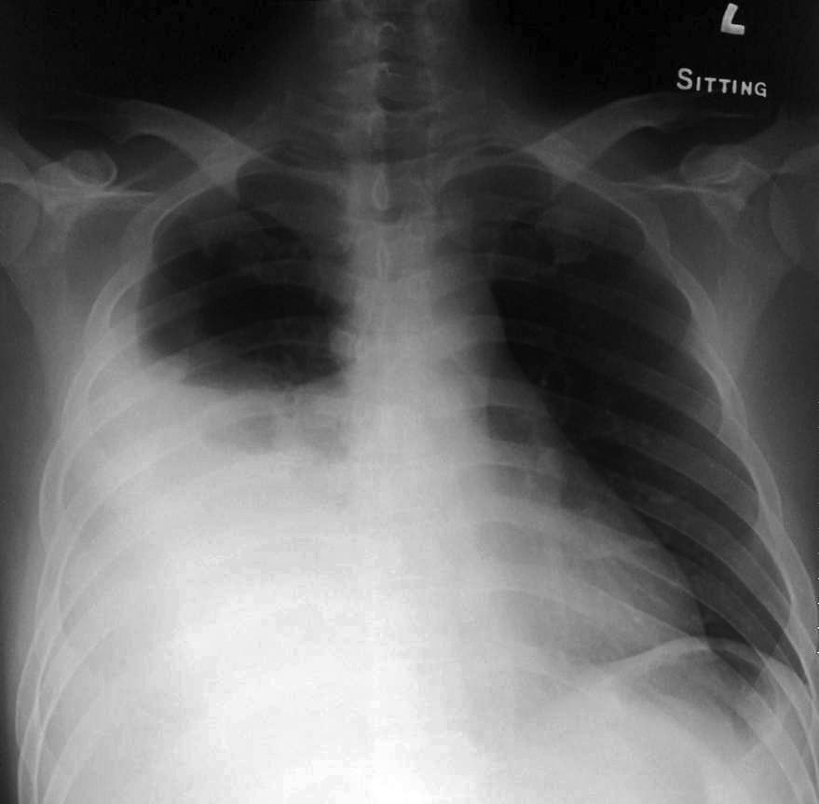
Case presentation
CXR

Slide 12
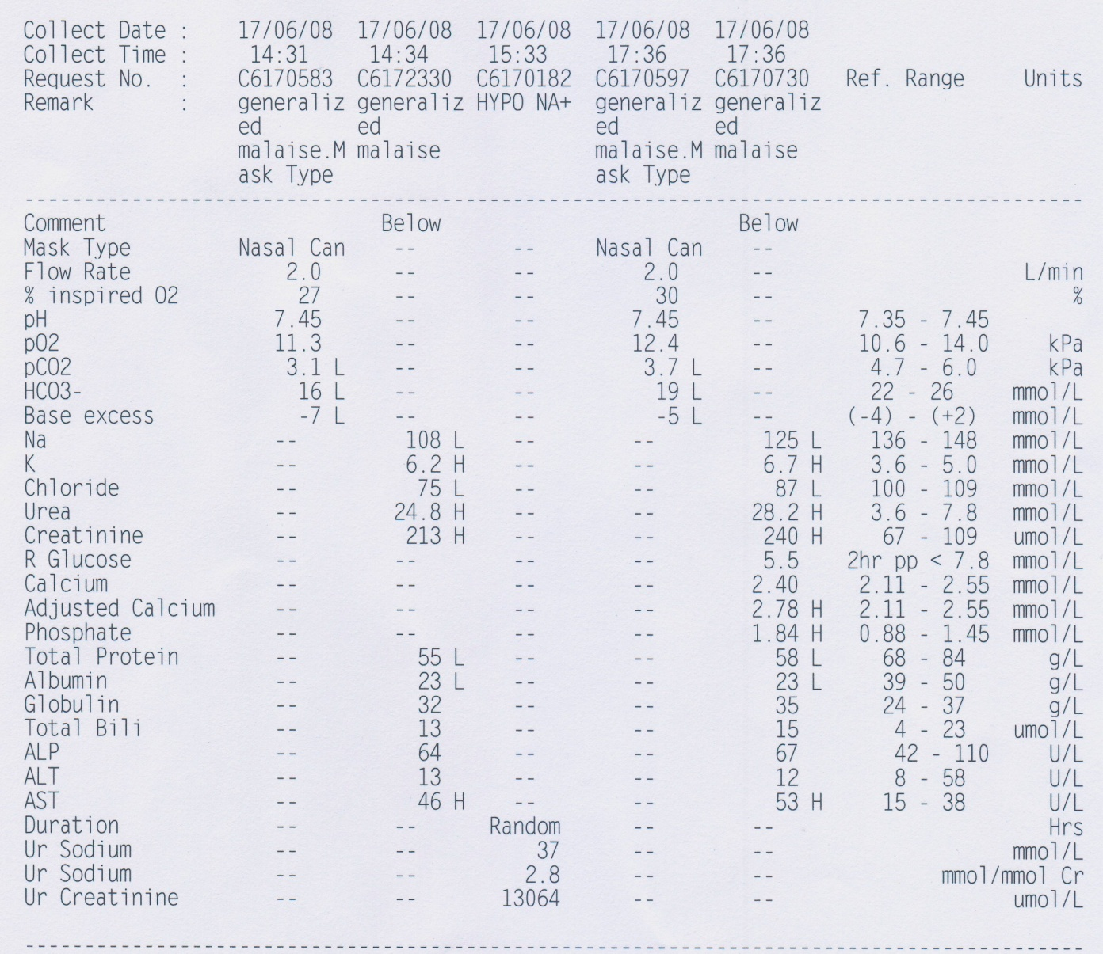
Case presentation
Notes:
RFT: Na/K 120/6.8 ;Cr/urea 257/29.1, baseline 105/9.0
ABG :pH 7.45, pO2 11.3, pCO2 3.1, HCO3 16, BE -7

Slide 13
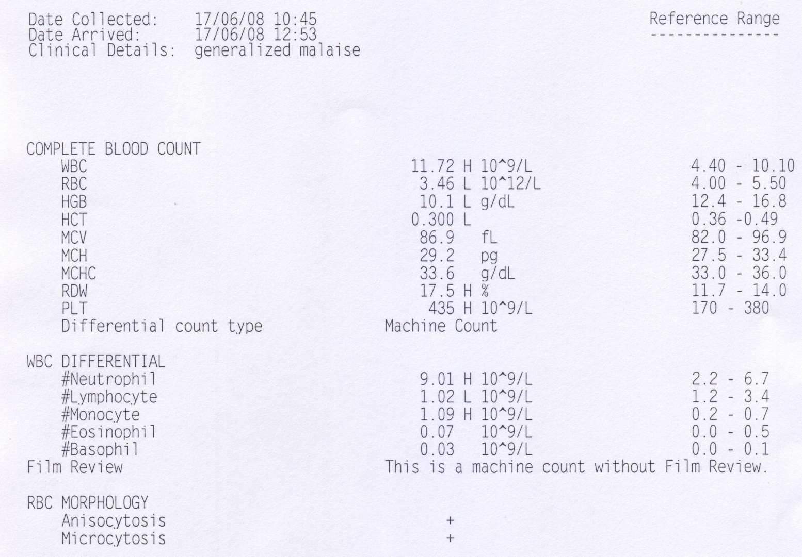
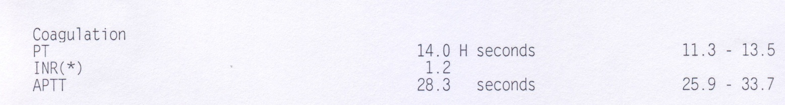
Case presentation

Slide 14
Case presentation
Progress in surgical ward
Given Ca gluconate, resonium for hyperkalaemia
Further drop in BP 77/54 mmHg, pulse 120 bpm, SaO₂ 95% with 2L/min O₂
Decrease urine output 15ml over 4 hours
Given fluid challenge 1L gelofusin
CVP inserted, 1st reading 9cm
CT abdomen/pelvis preformed, result pending
Persistent lowish BP
Consult ICU

Slide 15
Case presentation
Shock
  ?Urosepsis
  ?intra-abdominal sepsis/haemorrhage
Acute renal failure
Pleural effusion
Hyponatremia/hyperkalaemia
  ?Adrenal insufficiency
Underlying bilateral suprarenal mass
  Working diagnosis: Renal cell carcinoma
  Considered unresectable by urologist

Slide 16
Opinion Poll
Would you or your ICU admit this patient to the ICU for further care?
Questions | Answer
Your ICU will Admit this Patient. | Yes | No
The Patient will be labeled as “Do-Not-Resuscitate”. | Yes | No

Slide 17
Case presentation
Patient admitted to ICU
Empirical antibiotic after septic workup
CT abdomen/ pelvis
  Bilateral suprarenal masses (15x11x21 and 9x10x14cm)
  Vague internal hyperdensities within right side mass, could represent internal haemorrhage
  IVC largely compressed with anterior displacement
  Multiple shotty paraaortic LN
  Free fluid in pelvic region and bilateral paracolic gutters
  Right side pleural effusion with collapse right lower lobe

Slide 18
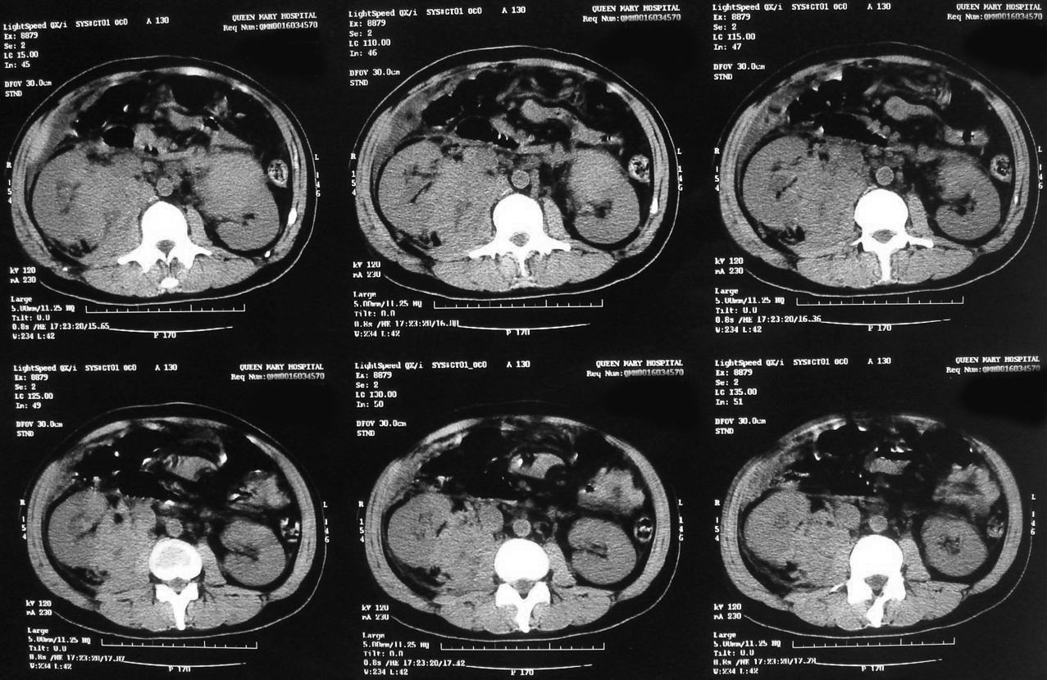
Case presentation
CT scan films
Notes:
Bilateral suprarenal masses (15x11x21 and 9x10x14cm)
Vague internal hyperdensities within right side mass, could represent internal haemorrhage
IVC largely compressed with anterior displacement
Multiple shotty paraaortic LN

Slide 19
Case presentation
Progress
Echocardiogram
  Hyperdynamic LV, moderate TR, thin rim of pericardial effusion
Started hydrocortisone for possible adrenal insufficiency / septic shock
Require vasopressor noradrenline ~0.25mcg/kg/min
Given DI drip, lasix, HCO₃⁻ for hyperkalaemia
Presistent oliguria, hyperkalaemia and acidosis
Stated CVVH

Slide 20
Case presentation
ICU day2
Spontaneous breathing with 2L/min O2, SaO2 95%
Require high dose noradrenaline 0.5mcg/kg/min
Hyperkalaemia/acidosis improved with CVVH
Still oliguric
  Cr 253→277
  Urea 32
  Na⁺/K⁺ 126/4.9
  Adj Ca²⁺ 2.65 / PO4 2.31
  Urate 951
Surgeon consulted for definite diagnosis of bilateral suprarenal mass
  Suggest laparotomy + biopsy when condition more stable

Slide 21
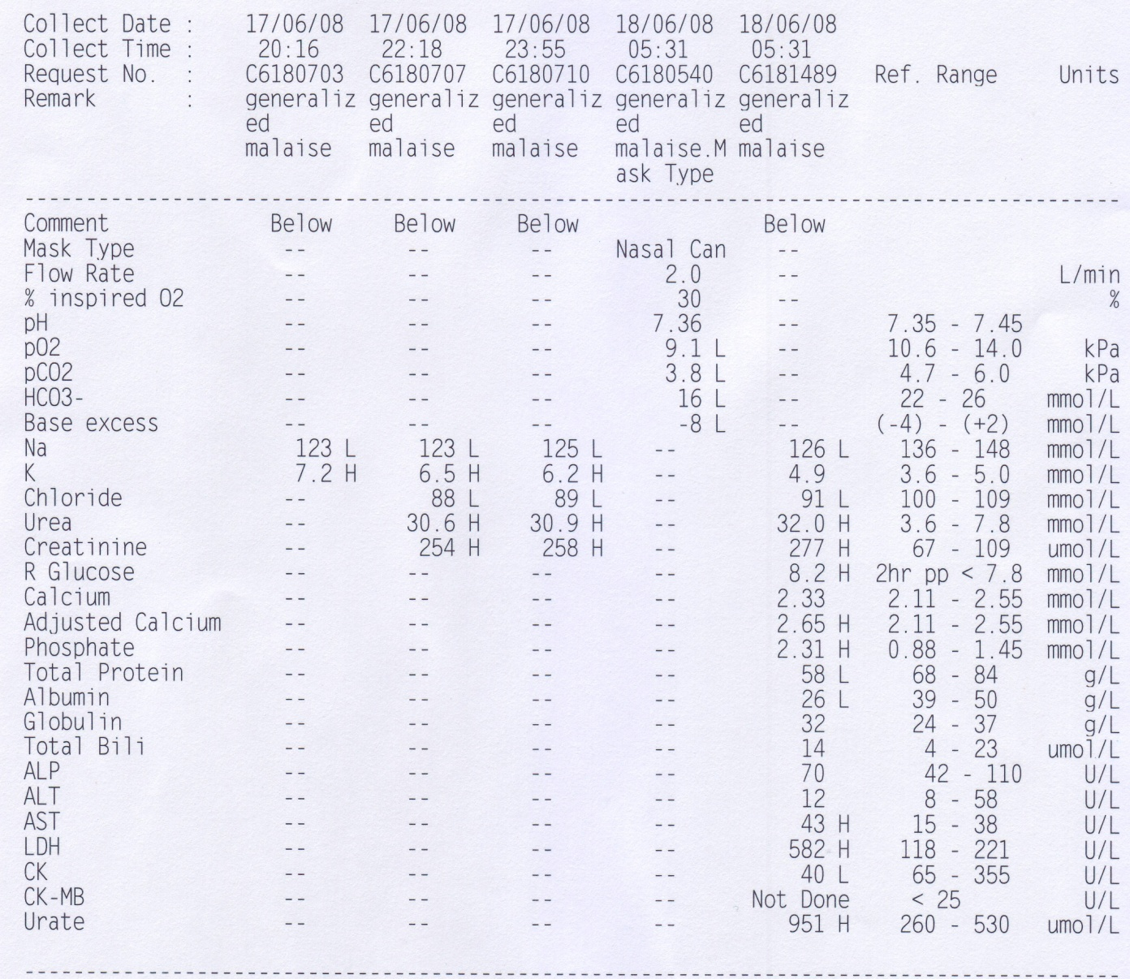
Case presentation

Slide 22
Case presentation
ICU day3
Still oliguria
Persistent high fever and leukocytosis despite empirical augmentin
Require increasing dosage of noradrenaline ~0.6mcg/kg/min
Blood culture/ urine culture so far no growth

Slide 23
Opinion Poll
Would you or your ICU “DNR” this patient?
Questions | Answer
Your ICU will Admit this Patient. | Yes | No
The Patient will be labeled as “Do-Not-Resuscitate”. | Yes | No

Slide 24
Case presentation
ICU day3
Discussion for DNR with relatives
  Continue support management
  Proceed to laparotomy + biopsy to confirm diagnosis if condition improve
  If further deteriorate / arrest before laparotomy, decided not for intubation/CPR

Slide 25
A Diagnostic Investigation was performed
ICU day 3
Laparotomy + biopsy
Repeat CT guided FNA
Bedside trucut biopsy of suprarenal mass
MRI
PET-CT
Pleural tap/ pleural biopsy
Others

Slide 26
Case presentation
ICU day3
USG guided pleural tapping + pigtail insertion
  Blood stained fluid
  Biochemistry
    Glucose 2.1
    pH 7.0
    Protein 41
    LDH 3663
  Cell count
    Total cell count 20500
    Neutrophil 20%
    Abnormal lymphoid cell 80%
    Medium to large size with high N/C ratio, fine to mildly condensed chromatin with several small nucleoli and fair amount of basophilic vacuolated cytoplasm

Slide 27
Case presentation
Dx
Spontaneous tumour lysis syndrome
  Acute Renal Failure
  Shock
  Hyperkalaemia
  Hyperuricaemia
?Underlying Lymphoma

Slide 28
Case presentation
Haematologist consulted
Review of pleural tapping result with flow cytometry
  Abnormal medium to large sized lymphoid cell
  Several prominent nucleoli and fairly abundant basophilic and vacuolated cytoplasm
  Immunophenotyping:
    41% B-cell, CD19+, CD20+
    Clonal with kappa light chain restriction and expressed xCD22, sIgM and sIgA
Consistent with pleural involvement by high grade B cells lymphoma

Slide 29
Case presentation
Started chemotherapy
  Methyprednisolone
  Vincristine
  Cyclophosphamide
In view of spontaneous tumour lysis syndrome and high risk of further lysis after chemotherapy
Started prophylactic Rasburicase 4.5mg besides allopurinol
IV rehydration
Bone marrow examination: no marrow involvement

Slide 30
Case presentation
Continued supportive management in ICU
  Vasopressor
  CVVH
  DNR order cancelled
  Fluid overload started CPAP
  Failed CPAP → intubation
  Oxygenation improved after negative fluid balance
  Extubated

Slide 31
Case presentation
Continued supportive management in ICU
  Renal function progressively improved, urine output resumed, stopped CVVH
    Cr 300→250→170→105
  Urate level progressively drop
    951 → 605 → 300→ 150
Discharged to haematology ward on day 11
  Chemotherapy continued

Slide 32
Case presentation
USG abdomen day 8 after chemotherapy
  Significant regression of bilateral suprarenal tumour mass compared with previous imaging study
  Right
    15 x 11 x 21cm → 5.3 x 5.5 x 5.9cm
  Left
    9 x 10 x 14cm → 4.5 x 3.6 x 3.4cm

Slide 33
Summary of Case Presentation
Bilateral suprarenal lymphoma
Spontaneous tumour lysis syndrome
  Acute renal failure
  Shock
Chemotherapy responsive
Prophylactic Rasburicase

Slide 34
Tumour Lysis Syndrome

Slide 35
Tumor lysis syndrome
Medical emergency caused by massive tumor cell lysis
Release massive quantities of intracellular contents into the systemic circulation
Most often occurs after the initiation of cytotoxic therapy
TLS can occur spontaneously
TLS associated with high mortality and morbidity

Slide 36
TLS - Definition
Cairo-Bishop definition
Laboratory TLS
  ≥2 below serum values revealing the following abnormalities
  uric acid ≥8 mg/dL (476 micromol/L) or ↑25% from baseline
  K⁺ ≥6.0 mmol/L or ↑25% from baseline
  PO₄³⁻ ≥1.45 mmol/L or ↑25% from baseline
  Ca²⁺ ≤1.75 mmol/L or ↓25% from baseline
  Present within -3 to +7day instituting chemotherapy
  Adequate hydration (with or without alkalinization)
  Use of a hypouricemic agent
Clinical TLS
  laboratory TLS +
  ↑ Serum creatinine concentration (≥1.5 times the upper limit of normal)
  Seizure
  Cardiac arrhythmia / Sudden death
Notes:
present within three days before or seven days after instituting chemotherapy in the setting of adequate hydration (with or without alkalinization) and use of a hypouricemic agent.

Slide 37
TLS - Pathogenesis
Rapid lysis of malignant cell
  High proliferative rate
  Large tumor burden
  High sensitivity to treatment
    Cytotoxic chemotherapy
    Cytolytic antibody therapy
    Radiation therapy
    Glucocorticoids
Releases massive quantities of intracellular contents
  K⁺
  PO₄³⁺
  Nucleic acids

Slide 38
TLS - Pathogenesis
Hyperphosphatemia
  Phosphorus concentration in malignant cells is up to four times higher than in normal cells
  Rapid tumor breakdown often leads to ↑PO₄³⁺
    Secondary hypocalcemia
  Increased risk of calcium phosphate precipitation
    [Ca²⁺] x [PO₄³⁺] > 60 mg²/dL²
    In renal tubules
      Acute Renal failure
    Heart
      Cardiac arrhythmias
Notes:
calcium phosphate product

Slide 39
TLS - Pathogenesis
Hyperuricemia
Poorly soluble in water
Crystal precipitation and deposition
  Renal tubules
  Acute uric acid nephropathy
  Acute renal failure
Purine
Hypoxanthine
Xanthine
Uric Acid
Allantoin
Xanthine Oxidase
Xanthine Oxidase
Urate Oxidase
Allopurinol
Exogenous Urate Oxidase
Notes:
Hyperuricemia is a consequence of the catabolism of purine nucleic acids to hypoxanthine and xanthine and then to uric acid via the enzyme xanthine oxidase
Uric acid is poorly soluble in water, particularly in the usually acidic environment in the distal tubules and collecting system of the kidney.
Overproduction and overexcretion of uric acid

Slide 40
TLS - Pathogenesis
Xanthinuria
Allopurinol blocks the catabolism of hypoxanthine and xanthine
Xanthine is much less soluble than uric acid
Urinary alkalinization increases the solubility of xanthine much less than the solubility of uric acid
Precipitation in renal tubules
  Acute renal failure
  Xanthine stone formation
Purine
Hypoxanthine
Xanthine
Uric Acid
Allantoin
Xanthine Oxidase
Xanthine Oxidase
Urate Oxidase
Allopurinol
Exogenous Urate Oxidase
Notes:
Allopurinol blocks the catabolism of hypoxanthine and xanthine, leading to an increase in the levels of these metabolites
Thus, patients with massive TLS who are receiving allopurinol are at risk for xanthine precipitation in the tubules, resulting in acute renal failure and xanthine stone formation, despite adequate hydration and urinary alkalinization

Slide 41
TLS - Clinical Manifestations
Nausea, Vomiting
Diarrhea
Anorexia, Lethargy
Heart failure, Cardiac Dysrhythmias
Seizures
Muscle cramps, Tetany
Syncope
Sudden death
Acute uric acid nephropathy
  Flank pain due to renal pelvic / ureteral stone formation
  Hematuria
  Uric acid crystals / Amorphous urates in urinalysis
Notes:
The symptoms associated with TLS largely reflect the associated metabolic abnormalities, Hyperkalemia, Hyperphosphatemia, Hypocalcemia
Acute uric acid nephropathy does not usually cause symptoms referable to the urinary tract, although flank pain can occur if there is renal pelvic or ureteral stone formation. The urinalysis typically shows many uric acid crystals or amorphous urates in an acid urine, but is occasionally relatively normal due to lack of output from the obstructed nephrons

Slide 42
TLS - Risk Factors
Tumour factor
  High tumor cell proliferation rate
  Chemosensitivity of the malignancy
    High-grade non-Hodgkin lymphomas (particularly Burkitt lymphomas)
    Acute lymphoblastic leukemia (ALL) (particularly Burkitt ALL)
    T/B-cell precursor ALL, AML, CLL, multiple myeloma, isolated plasmacytoma
  Large tumor burden
    bulky disease >10 cm in diameter
    white blood cell count >50,000 per microL
    pretreatment serum LDH > 2x ULN
Patient factor
  Pretreatment hyperuricemia
  Hyperphosphatemia
  Preexisting renal impairment
  Volume depletion
Notes:
Certain intrinsic tumor-related factors are associated with a higher risk
The tumors most frequently associated with tumor lysis syndrome are High-grade non-Hodgkin lymphomas and Acute lymphoblastic leukemia (ALL)
Other hematologic malignancies that are less commonly associated with TLS include T-cell or B-cell precursor ALL, acute myeloid leukemia (AML), chronic lymphocytic leukemia (CLL), and plasma cell disorders, such as multiple myeloma and isolated plasmacytomas
There are also clinical features that predispose to the development of TLS

Slide 43
TLS - Risk Stratification
Type of Cancer | High Risk | Intermediate Risk | Low Risk
NHL | Burkitt's Lymphoblastic Burkitt's -ALL | DLBCL | Indolent NHL
ALL | WBC 100,000/microL | WBC 50,000-100,000/microL | WBC 50,000/microL
AML | WBC 50,000/microL, monoblastic | WBC 10,000-50,000/microL | WBC 10,000/microL
CLL |  | WBC 10,000-100,000/microL treated with fludarabine | WBC 10,000/microL
Other haematological disease and solid tumour |  | Rapid proliferation with expected rapid response to therapy | Remainder of patients
Coiffier, B, Altman, A, Pui, CH, et al. Guidelines for the management of pediatric and adult tumor lysis syndrome: an evidence-based review. J Clin Oncol 2008; 26:2767.
Notes:
In 2008, an international expert panel published evidence-based guidelines for the prevention and management of TLS. A risk stratification system for TLS was proposed using the type of malignancy, the burden of disease, treatment, and expected response to treatment. The recommended therapy varied with the risk category.
Included in the high-risk group were all patients with Burkitt non-Hodgkin lymphoma (NHL) or Burkitt ALL, other ALL with a WBC ≥100,000 per microL, and AML (especially of the monoblastic type) with WBC ≥50,000 per microL
Intermediate-risk - The intermediate-risk group included patients with diffuse large cell B cell lymphoma, non B-ALL and a WBC 50,000 to 100,000/microL, AML with a WBC between 10,000 and 50,000/microL, fludarabine-treated patients with CLL and a WBC 10,000 to 100,000/microL, and other hematologic or solid tumors with rapid proliferation and an expected rapid response to therapy.
Low-risk — Patients at low risk for TLS were those with indolent NHL or other slowly proliferating malignancy, including ALL with a WBC ≤50,000/microL, AML or CLL with a WBC ≤10,000/microL, and all other patients with hematologic malignancies or other solid tumors.

Slide 44
TLS - Management
The best management of TLS is prevention
TLS – associated with high mortality, morbidity & cost
  Retrospective series of 772 consecutive patients undergoing induction chemotherapy for AML
    Patients with TLS : mortality 79%
    Patients without evidence of TLS: mortality: 23%
    Tumor lysis syndrome in patients with acute myeloid leukemia: identification of risk factors and development of a predictive model. Montesinos P; Lorenzo I; Martin G; Sanz J; Perez-Sirvent ML; Martinez D; Orti G; Algarra L; Martinez J; Moscardo F; de la Rubia J; Jarque I; Sanz G; Sanz MA; Haematologica. 2008 Jan;93(1):67-74
  Analysis of data from the Health Care Utilization project on 600,000 patients treated for a hematologic malignancy
    Patients with TLS and Renal failure
      Significantly longer hospital stay (21 versus 7 days)
      Five-fold higher total cost per discharge
    A comparison of inpatientlength of stay and costs among patients with hematologic malignancies (excluding hodgkin disease) associated with and without acute renal failure. Candrilli, S, Bell, T, Irish, W, et al. Clin Lymphoma Myeloma 2008; 8:44.
Notes:
The clinical impact of TLS was addressed in the previously cited retrospective series of 772 consecutive patients undergoing induction chemotherapy for acute myeloid leukemia AML.
TLS was associated with a significantly higher risk of death during induction therapy (79 % versus 23 %) in those without evidence of TLS
In addition to an increase in mortality, the development of TLS is also associated with increased complications and costs as illustrated by an analysis of data from the Health Care Utilization project in USA on 600,000 patients treated for a hematologic malignancy, patients who developed acute renal failure requiring dialysis had a significantly longer hospital stay (21 versus 7 days) and five-fold higher total cost per discharge than did those who did not develop renal failure

Slide 45
TLS - Prevention
Intravenous Hydration
  Recommended prior to therapy in all patients at intermediate or high risk for TLS
  To induce a high urine output
    Minimize uric acid precipitation in renal tubules
  Potentially dangerous in patients with underlying renal insufficiency or cardiac dysfunction
The 2008 International Expert Panel
  Guidelines for the management of pediatric and adult tumor lysis syndrome: an evidence-based review. Coiffier, B, Altman, A, Pui, CH, et al. J Clin Oncol 2008; 26:2767.
  IV fluid 2 to 3 L/m²/day
  Urine output 80 to 100 mL/m²/h
  Diuretics can be used to maintain the urine output, if necessary
The choice of hydration fluid depends upon the clinical circumstances.
  5% dextrose one-quarter normal saline
  Avoid K⁺, Ca²⁺
Notes:
The 2008 International Expert Panel recommended that both children and adults initially receive 2 to 3 L/m2 per day of IV fluid. Urine output should be monitored closely and maintained within a range of 80 to 100 mL/m2 per hour. Diuretics can be used to maintain the urine output, if necessary.
The choice of hydration fluid depends upon the clinical circumstances. The expert panel suggests the initial use of 5% dextrose one-quarter normal (isotonic) saline. In patients with hyponatremia or volume depletion, isotonic saline should be the initial hydration fluid. Due to the risk of hyperkalemia and hyperphosphatemia with calcium phosphate precipitation once tumor breakdown begins, potassium and calcium should be withheld from the hydration fluids, at least initially.

Slide 46
TLS - Prevention
Urinary Alkalinization
  Unclear and controversial
  Aim urine pH 6.5 to 7.0
  Uric aicd → urate salt (more soluble)
  ↓Uric acid precipitation in renal tubules
No data demonstrating the efficacy of urinary alkalinization
Experimental study
  Hydration with saline alone is as effective as alkalinization in minimizing uric acid precipitation
Potential disadvantage
  Promoting calcium phosphate deposition in the kidney, heart, and other
Expert panel recommendation
  Use of HCO₃⁻ was only indicated in patients with metabolic acidosis
Notes:
The role of urinary alkalinization with either acetazolamide and/or NaHCO3 is unclear and controversial.
In the past, alkalinization to a urine pH of 6.5 to 7.0 or even higher was recommended to convert uric acid to the more soluble urate salt, thereby diminishing the likelihood of uric acid precipitation in the tubules
However, this approach has fallen out of favor
Alkalinization of the urine has the potential disadvantage of promoting calcium phosphate deposition in the kidney, heart, and other organs in patients who develop marked hyperphosphatemia once tumor breakdown begins.
Based upon these observations, the expert panel concluded that use of sodium bicarbonate was only indicated in patients with metabolic acidosis

Slide 47
TLS - Prevention
Allopurinol
  Hypoxanthine analog
  Competitively inhibits xanthine oxidase
  Effectively ↓ new uric acid formation
  Reduces incidence of obstructive uropathy
Purine
Hypoxanthine
Xanthine
Uric Acid
Allantoin
Xanthine Oxidase
Xanthine Oxidase
Urate Oxidase
Allopurinol
Exogenous Urate Oxidase
Notes:
hypoxanthine analog that competitively inhibits xanthine oxidase, blocking the metabolism of hypoxanthine and xanthine to uric acid
effectively decreases the formation of new uric acid and reduces the incidence of obstructive uropathy in patients with malignant disease at risk for TLS

Slide 48
TLS - Prevention
Limitation of Allopurinol
  Acts by ↓uric acid formation
    Does not reduce serum uric acid concentration
  ↑Serum levels of the purine precursors hypoxanthine and xanthine
    Deposition of xanthine crystals in renal tubules
    Acute renal failure
  ↓Degradation of other purines
    6-mercaptopurine
    Azathioprine
  Drug interaction
Notes:
However, there are several limitations to its use
Because allopurinol acts by decreasing uric acid formation, allopurinol does not reduce the serum uric acid concentration before treatment is initiated.
Allopurinol increases serum levels of the purine precursors hypoxanthine and xanthine, which may lead to xanthinuria, deposition of xanthine crystals in the renal tubules, and acute renal failure.
Since allopurinol also reduces the degradation of other purines, dose reductions of 65 to 75 percent are needed in patients being treated with 6-mercaptopurine or azathioprine
Allopurinol has the potential to interact with a number of other drugs, including cyclophosphamide, high-dose methotrexate, ampicillin, and thiazide diuretics.

Slide 49
TLS - Prevention
Rasburicase
  Recombinant Urate Oxidase
  Produce by cloning of the gene encoding urate oxidase in Aspergillus flavus
  Rapidly ↓serum uric acid
  Effective in preventing and treating hyperuricemia and TLS
Purine
Hypoxanthine
Xanthine
Uric Acid
Allantoin
Xanthine Oxidase
Xanthine Oxidase
Urate Oxidase
Allopurinol
Exogenous Urate Oxidase
Notes:
catalyzes oxidation of uric acid to the much more water-soluble compound allantoin . Urate oxidase is present in most mammals but not humans.
rapidly lowers serum uric acid, and is effective in preventing and treating hyperuricemia and TLS. The rapid reduction in serum uric acid is in contrast to the effect of allopurinol, which decreases uric acid formation and therefore does not acutely reduce the serum uric acid concentration.

Slide 50
TLS – Efficacy of Rasburicase
Efficacy and safety of rasburicase for the prevention and treatment of hyperuricemia during induction chemotherapy of aggressive non-Hodgkin's lymphoma
  Coiffier B; Mounier N; Bologna S; Ferme C; Tilly H; Sonet A; Christian B; Casasnovas O; Jourdan E; Belhadj K; Herbrecht R SO J Clin Oncol 2003 Dec 1;21(23):4402-6. Epub 2003 Oct 27.
100 patients with aggressive NHL
  ↑LDH 66%
  Hyperuricemia at presentation 11%
Rasburicase
  0.2 mg/kg IV per day
  Started at one day before / day 1 chemotherapy
  For a total of 3-7 days
Results
  Control of uric acid was obtained within four hours of the first dose in all patients
  Maintained throughout the period of observation
  No patient had ↑serum creatinine
  K⁺, PO₄³⁻, Ca²⁺ all well controlled
  3 patient discontinued treatment because of a grade 3 ↑liver enzymes
Notes:
100 patients with aggressive NHL who were considered at high risk for TLS

Slide 51
TLS - Rasburicase
Superiority of rasburicase versus allopurinol on serum uric acid control in adult patients with hematological malignancies at risk of developing tumor lysis syndrome: Results of a ranedomized comparative phase III study.
  Cortes, J, Seiter, K, Maziarz, RT, et al. .Blood 2008; 112
Rasburicase vs Allopurinol
280 adults with hematologic malignancies at risk for TLS
  Rasburicase (0.2 mg/kg daily on days 1 to 5)
  Rasburicase (on days 1 to 3) + allopurinol (300 mg daily on days 3 to 5)
  Allopurinol (300 mg daily on days 1 to 5)
Results
  Number of patients with normalization of serum uric acid at days 3 to 7
    87% vs 78% vs 66%
  Time to control serum uric acid
    4.1h versus 27h
Notes:
In the only adult phase III trial to compare rasburicase versus allopurinol,
280 adults with hematologic malignancies at risk for TLS were randomly assigned to rasburicase alone, rasburicase plus oral allopurinol or allopurinol alone
In a preliminary report, normalization of serum uric acid at days 3 to 7 was achieved by a higher percentage of patients in the rasburicase alone group
Rasburicase was also superior to allopurinol alone in time to control serum uric acid

Slide 52
TLS - Rasburicase
FDA recommended dosage
  0.15 to 0.2 mg/kg once daily for 5 days
  Supplied in vials containing 1.5 / 7.5 mg
Price: 1.5mg x 3 vials/pack: $2056 ;Average cost / 1.5mg vial: $685.3
2008 International Expert Panel recommended dosage
  Duration of therapy
    1 to 7 days
    Average 2 days
  ↑ to BD dose when tumor lysis is massive
  Limited data for single dose regime
TLS Profile | Baseline uric acid |  | Dose | Duration
High risk | >7.5mg/dL | 450mmol/L | 0.2 mg/kg | Based on plasma uric acid levels
Intermediate risk | <7.5 | 450 | 0.15 | Based on plasma uric acid levels
Low risk | <7.5 | 450 | 0.10 | Clinical judgment
Coiffier, B, Altman, A, Pui, CH, et al. Guidelines for the management of pediatric and adult tumor lysis syndrome: an evidence-based review. J Clin Oncol 2008; 26:2767.
Notes:
single daily dose for a 70 kg adult receiving 0.2 mg/kg is about $4400
The duration of rasburicase therapy depends upon the degree of control of serum uric acid levels
Limited data suggest that a single dose of rasburicase (1.5 to 6 mg) effectively and rapidly lowers serum levels of uric acid in patients who are at risk for or already have TLS. However, the clinical scenarios in which a single dose might be preferred to conventional dosing have not been defined

Slide 53
TLS - Rasburicase
Contraindication
  Pregnancy
  Lactation
  Glucose-6-phosphate dehydrogenase (G6PD) deficiency
    Hydrogen peroxide as a byproduct
    Screening for G6PD
H₂O₂
Purine
Hypoxanthine
Xanthine
Uric Acid
Allantoin
Xanthine Oxidase
Xanthine Oxidase
Urate Oxidase
Allopurinol
Exogenous Urate Oxidase
Notes:
because hydrogen peroxide, a byproduct of uric acid breakdown, can cause severe hemolysis and methemoglobinemia in patients with the enzyme deficiency.
Patients being considered for rasburicase, especially males who have the potential for G6PD deficiency should undergo screening tests.

Slide 54
TLS - Treatment
Treatment of spontaneous / established TLS
  Rasburicase
  Electrolyte disturbance
    Hyperphosphatemia
    Hypocalcemia
    Hyperkalemia
  Acute renal failure
    Wash out obstructing uric acid crystals
      Loop diuretic / fluids
    Renal replacement therapy

Slide 55
TLS - Treatment
Treatment of spontaneous / established TLS
  Acute renal failure
    Renal replacement therapy
  Need for RRT ↓with use of rasburicase
  Good prognosis of renal function
    Oliguria due to acute uric acid nephropathy responds quickly to RRT
  Hemodialysis
    uric acid clearance : 70 to 100 mL/min
  Peritoneal dialysis
    uric acid clearances < 10 mL/min
  CAVHD / CVVH / CVVHD may also be effective
Notes:
The need for dialysis during induction therapy for high-risk hematologic malignancies has substantially declined since the introduction of rasburicase

Slide 56
Summary
TLS is a medical emergency
  Hyperuracemia, hyperphosphataemia, hypocalcaemia
  Acute renal failure
The best management is prevention
  IV fluid rehydration
  Allopurinol
  Use of Rasburicase in high to immediate risk patients
Spontaneous TLS established TLS
  Rasburicase is effective in lowering uric acid level
Supportive care
  Electrolyte disturbance
  Renal replacement therpay

Slide 57
Opinion Poll Results
Questions | Answer
Your ICU will Admit this Patient. | Yes | No
The Patient will be labeled as “Do-Not-Resuscitate”. | Yes | No

Slide 58
Thank you

