Slide 1
Use of ECMO in Severe Sepsis
Dr LAU Chun Wing, Arthur
Associate Consultant
Intensive Care Unit
Pamela Youde Nethersole Eastern Hospital, Hong Kong
Presented at the ECMO Case Discussion Meeting co-organized with ICU, United Christian Hospital on 23rd January, 2015

Slide 2
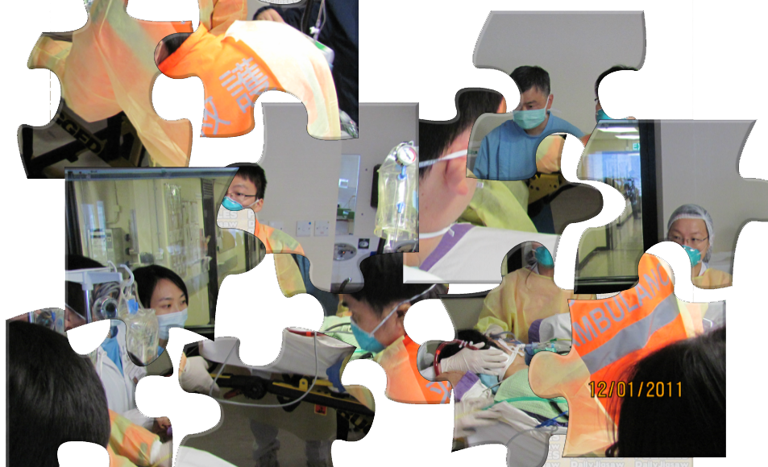
Life is like a giant puzzle. Everyday we struggle to find its pieces to make it into a complete picture.

Slide 3
Issues to discuss
History: Use of ECMO in severe sepsis and outcomes
Literature review
Technical aspects
Possible reasons to explain such outcomes
Conclusion and Future research

Slide 4
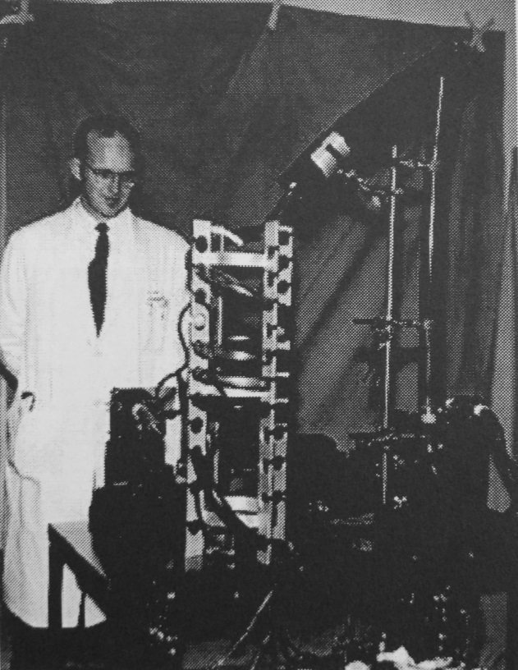
1. History
Bubble oxygenator in 1954
Use of ECMO in severe sepsis and outcomes

Slide 5
History of usage of ECMO
 | In general | Neonatal | Pediatric | Adults
1970s | CI for sepsis | 1976: first neonatal ECMO For resp failure | For resp failure | 1972: first adult ECMO For resp failure
1990s | Could be lifesaving in neonatal and pediatric septic shock | UK Collaborative ECMO Trial Group. UK collaborative randomised trial of neonatal ECMO. Lancet 1996; 348: 75-82. Overall survival 80% (90% survival for meconium aspiration syndrome, lower in congenital diaphragmatic hernias) | Expected survival not higher than 50% | Not to be used Poor outcomes
21st century to date | Standard indication for refractory septic shock in neonates | Cost-effectiveness data available Bennett CC, Johnson A, Field DJ, et al. UK collaborative randomised trial of neonatal ECMO: follow-up to age 4 years. Lancet 2001; 357: 1094-6. ELSO and U Michigan survival rate: around 80% | Surviving Sepsis Campaign 2012: Consider ECMO for refractory pediatric septic shock and resp failure (Grade 2C) With high flow, central ECMO with modern circuitry, survival approaching 75% | CESAR Study of overall benefit Isolated case reports of efficacy in sepsis, but definite outcome data not available, survival worse than neonates and paediatrics
Ref: Dellinger RP, et al. Surviving Sepsis Campaign: International guidelines for management of severe sepsis and septic shock: 2012. Crit Care Med. 2013; 41:580-637

Slide 6
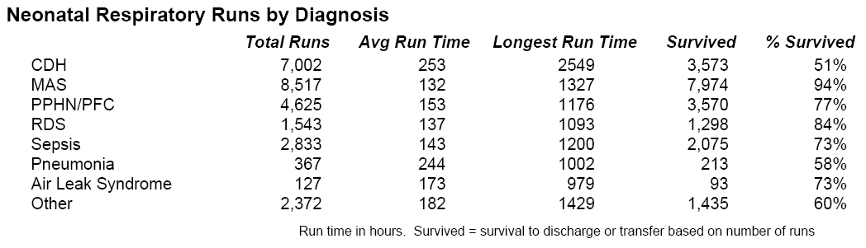
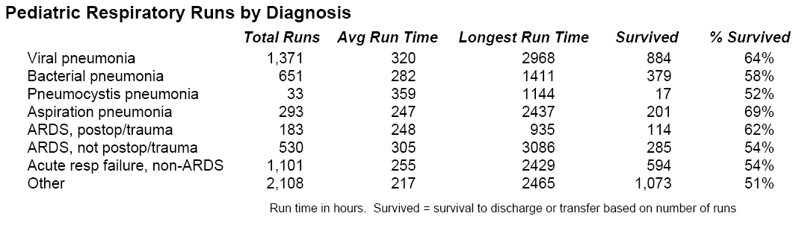
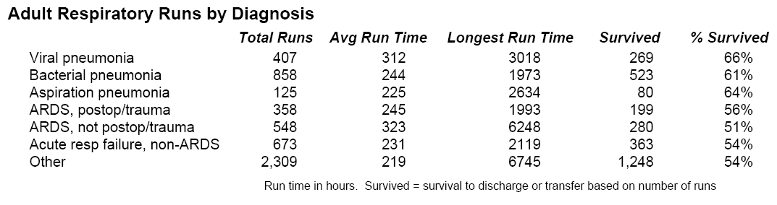
ELSO Diagnoses (<1986 – 2013)
ELSO Definition of sepsis:
The presence of pathogenic
microorganisms or their toxins in the blood or other tissues. It may be diagnosed clinically by symptomatic evidence of infection, or by laboratory studies. It may also be diagnosed by a documented positive culture.
ELSO definition of survival was successful separation from ECMO.
Ref: ELSO Registry, accessed Dec 2014

Slide 7

2. Literature review

Slide 8
Authors and Journals | Case report titles
Kahn JM, Müller HM, Kulier A, Keusch-Preininger A, Tscheliessnigg KH. Anesth Analg. 2006 May;102(5):1597-8. | Veno-arterial extracorporeal membrane oxygenation in acute respiratory distress syndrome caused by leptospire sepsis.
Lamarche Y, Cheung A, Walley KR, Dodek P. J Thorac Cardiovasc Surg. 2009 Jul;138(1):246-7. doi: 10.1016/j.jtcvs.2008.05.030. Epub 2008 Aug 15. No abstract available. | Combined use of extracorporeal membrane oxygenation and activated protein C for severe acute respiratory distress syndrome and septic shock.
Vohra HA, Adamson L, Weeden DF, Haw MP. Ann Thorac Surg. 2009 Jan;87(1):e4-5. doi: 10.1016/j.athoracsur.2008.07.077. | Use of extracorporeal membrane oxygenation in the management of septic shock with severe cardiac dysfunction after Ravitch procedure.
Vohra HA1, Jones C, Viola N, Haw MP. Interact Cardiovasc Thorac Surg. 2009 Feb;8(2):272-4. doi: 10.1510/icvts.2008.189407. Epub 2008 Nov 10. | Use of extra corporeal membrane oxygenation in the management of sepsis secondary to an infected right ventricle-to-pulmonary artery Contegra conduit in an adult patient.
Firstenberg MS1, Blais D, Abel E, Louis LB, Sun B, Mangino JE. Heart Surg Forum. 2010 Dec;13(6):E376-8. doi: 10.1532/HSF98.20101072. | Fulminant Neisseria meningitidis: role for extracorporeal membrane oxygenation.
MacLaren G1, Cove M, Kofidis T. Ann Thorac Surg. 2010 Sep;90(3):e34-5. doi: 10.1016/j.athoracsur.2010.06.019. | Central extracorporeal membrane oxygenation for septic shock in an adult with H1N1 influenza.
Firstenberg MS1, Abel E, Blais D, Louis LB, Steinberg S, Sai-Sudhakar C, Martin S, Sun B. Am Surg. 2010 Nov;76(11):1287-9. | The use of extracorporeal membrane oxygenation in severe necrotizing soft tissue infections complicated by septic shock.
Kamath SS, Mason K. Ann Thorac Cardiovasc Surg. 2011;17(4):397-9. Review. | Extra-corporeal membrane oxygenation in a patient with Fusobacterium sepsis: a case report and review of literature.
Gorjup V1, Fister M, Noc M, Rajic V, Ribaric SF. Respir Care. 2012 Jul;57(7):1178-81. doi: 10.4187/respcare.01393. Epub 2012 Feb 24. | Treatment of sepsis and ARDS with extracorporeal membrane oxygenation and interventional lung assist membrane ventilator in a patient with acute lymphoblastic leukemia. (F/18, S. epidermidis, VV-ECMO then Novalung)

Slide 9
Authors and Journals | Case report titles
Gabel E1, Gudzenko V, Cruz D, Ardehali A, Fink MP. J Intensive Care Med. 2013 Dec 25. [Epub ahead of print] | Successful Use of Extracorporeal Membrane Oxygenation in an Adult Patient With Toxic Shock-Induced Heart Failure.
Hagiwara S, Murata M, Aoki M, Kaneko M, Oshima K. Hippokratia. 2013 Apr;17(2):171-3. | Septic shock caused by Klebsiella oxytoca: An autopsy case and a survival case with driving Extracorporeal Membrane Oxygenation.
Orr C1, McCarthy C, Gunaratnam C, Kearns G. Ir Med J. 2013 Jul-Aug;106(7):213-4. | Life threatening sepsis while on high dose steroids requiring extra-corporeal membrane oxygenation.
van der Geest PJ, van der Jagt M, van Thiel R, van Bommel J. Anaesth Intensive Care. 2013 Mar;41(2):262-3. | Acute respiratory distress syndrome with refractory hypoxaemia and severe septic shock caused by melioidosis: successful treatment with veno-venous extracorporeal membrane oxygenation.
Gabel E, Gudzenko V, Cruz D, Ardehali A, Fink MP. J Intensive Care Med. 2013 Dec 25. [Epub ahead of print] | Successful Use of Extracorporeal Membrane Oxygenation in an Adult Patient With Toxic Shock-Induced Heart Failure.
J Intensive Care. 2014 Feb 18;2(1):13. doi: 10.1186/2052-0492-2-13. eCollection 2014. Endo A1, Shiraishi A1, Aiboshi J1, Hayashi Y2, Otomo Y1. | A case of purpura fulminans caused by Hemophilus influenzae complicated by reversible cardiomyopathy.
In Vivo. 2014 Sep-Oct;28(5):961-5. Fujisaki N1, Takahashi A2, Arima T2, Mizushima T2, Ikeda K2, Kakuchi H2, Nakao A3, Kotani J4, Sakaida K2. | Successful treatment of Panton-Valentine leukocidin-expressing Staphylococcus aureus-associated pneumonia co-infected with influenza using extracorporeal membrane oxygenation.
BMC Anesthesiol. 2014 May 21;14:37. doi: 10.1186/1471-2253-14-37. eCollection 2014. De Rosa FG1, Fanelli V2, Corcione S1, Urbino R2, Bonetto C2, Ricci D3, Rinaldi M3, Di Perri G1, Bonora S1, Ranieri MV2. | Extra Corporeal Membrane Oxygenation (ECMO) in three HIV-positive patients with acute respiratory distress syndrome.
J Paediatr Child Health. 2014 Sep;50(9):687-92. doi: 10.1111/jpc.12601. Epub 2014 Jun 9. Lithgow A1, Duke T, Steer A, Smeesters PR. | Severe group A streptococcal infections in a paediatric intensive care unit.

Slide 10
Case series
Authors and Journals | Case series titles | N and Survival | Study Time
Bréchot N1, Luyt CE, Schmidt M, Leprince P, Trouillet JL, Léger P, Pavie A, Chastre J, Combes A. Crit Care Med. 2013 Jul;41(7):1616-26. doi: 10.1097/CCM.0b013e31828a2370. | Venoarterial extracorporeal membrane oxygenation support for refractory cardiovascular dysfunction during severe bacterial septic shock. | N = 14 71.4% Age: 28 - 66 | 2008 - 2011
Cheng A1, Sun HY, Lee CW, Ko WJ, Tsai PR, Chuang YC, Hu FC, Chang SC, Chen YC. J Crit Care. 2013 Aug;28(4):532.e1-10. doi: 10.1016/j.jcrc.2012.11.021. Epub 2013 Mar 19. | Survival of septic adults compared with nonseptic adults receiving extracorporeal membrane oxygenation for cardiopulmonary failure: a propensity-matched analysis | N = 108 24.4% Matched with 108 non-septic 34.9% | 2001 - 2009
Huang CT1, Tsai YJ, Tsai PR, Ko WJ. J Thorac Cardiovasc Surg. 2013 Nov;146(5):1041-6. doi: 10.1016/j.jtcvs.2012.08.022. Epub 2012 Sep 7. | Extracorporeal membrane oxygenation resuscitation in adult patients with refractory septic shock. | N = 52 15% | 2005 – 2010)
Park TK1, Yang JH2, Jeon K3, Choi SH1, Choi JH1, Gwon HC1, Chung CR3, Park CM3, Cho YH4, Sung K4, Suh GY3. Eur J Cardiothorac Surg. 2014 Nov 25. pii: ezu462. [Epub ahead of print] | Extracorporeal membrane oxygenation for refractory septic shock in adults. | N = 32 21.9% | 2005 - 2013

Slide 11
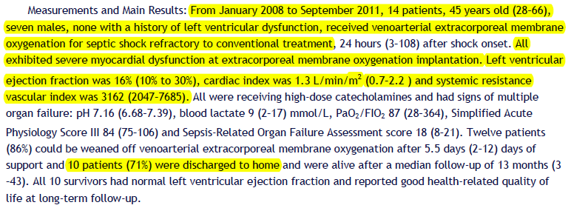
Venoarterial extracorporeal membrane oxygenation support for refractory cardiovascular dysfunction during severe bacterial septic shock
N = 14 adults with sepsis-associated cardiac failure
All femoro-femoral VA ECMO
Blood flow 4 to 5 LPM
Bréchot, N, et al. Critical care medicine 2013

Slide 12
Bréchot, N, et al. Critical care medicine 2013

Slide 13
N = 14
Shock onset to ECMO interval: 24 hours (3 to 108 hrs)
All femoral VA-ECMO
Echo: LVEF 16% (10 – 30), No LV dilatation, RV dysfunction = 3
No cardiac arrest before ECMO
Hemodynamic profile: Low CI, inc filling pressure, profound myocardial depression, elevated SVR
Bréchot, N, et al. Critical care medicine 2013

Slide 14
Outcomes
Bréchot, N, et al. Critical care medicine 2013

Slide 15
Bréchot, N, et al. Critical care medicine 2013

Slide 16
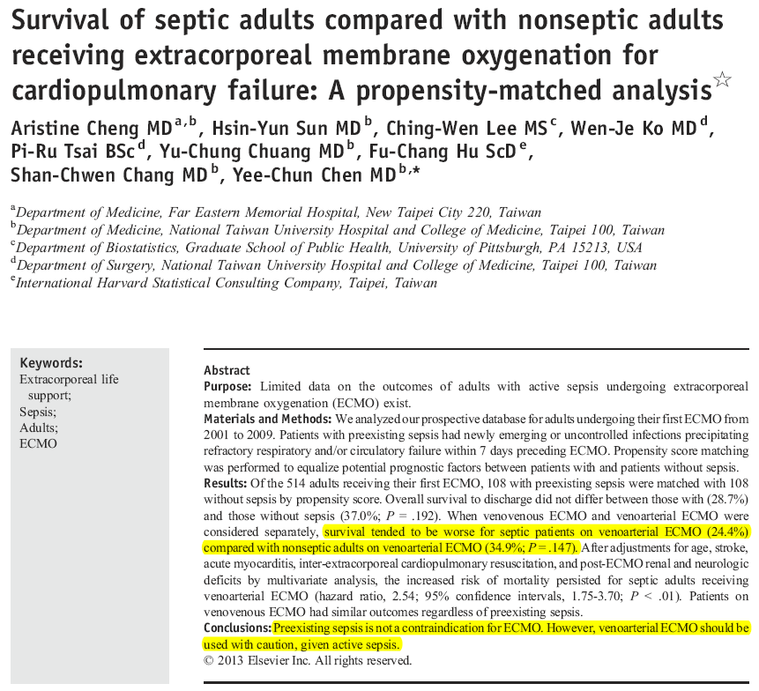
Cheng A, et al. J Crit Care 2013

Slide 17
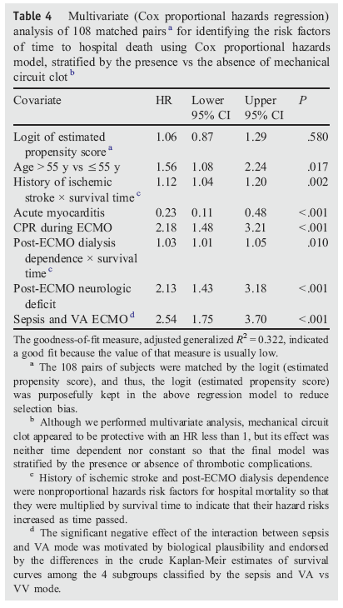
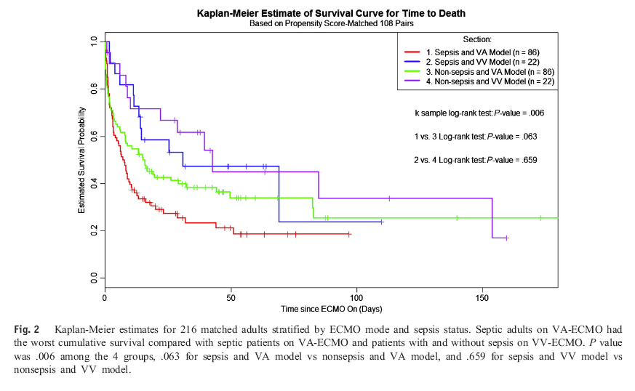
Sepsis-related shock vs Non-septic-related shock
VA-ECMO - Sepsis-related shock: worse outcome
VV-ECMO – Sepsis and non-sepsis-related respiratory failre: no difference in outcome
Cheng A, et al. J Crit Care 2013

Slide 18
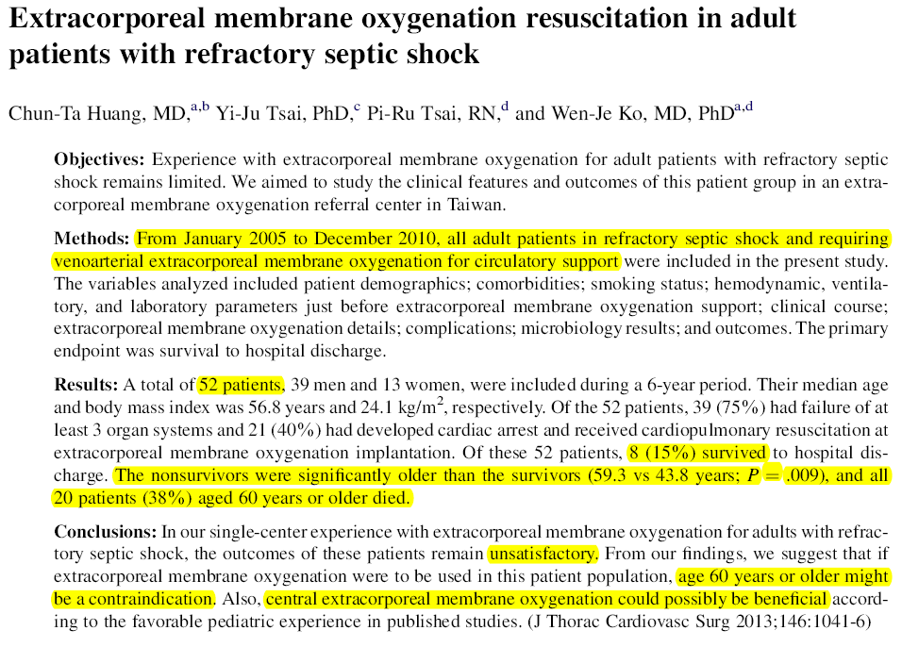
All peripheral VA ECMO
National Taiwan University Hospital
Huang CT, et al. J Thorac Cardiovasc Surg. 2013

Slide 19
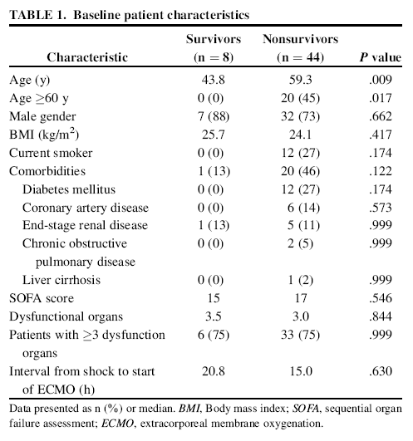
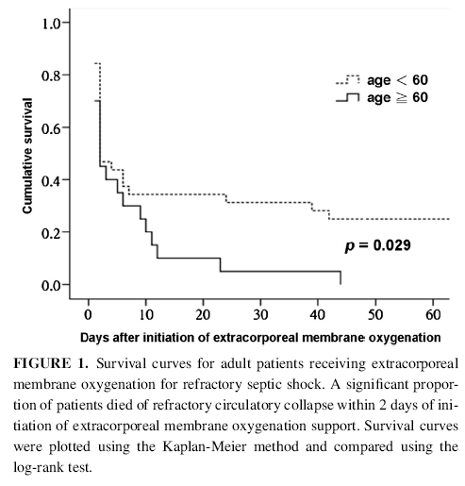
Most have preserved LV function at start of ECMO
40% had received CPR before ECMO, Blood flow started at 2 – 2.5 L/min and adjusted
No patient received left-sided decompression
Huang CT, et al. J Thorac Cardiovasc Surg. 2013

Slide 20
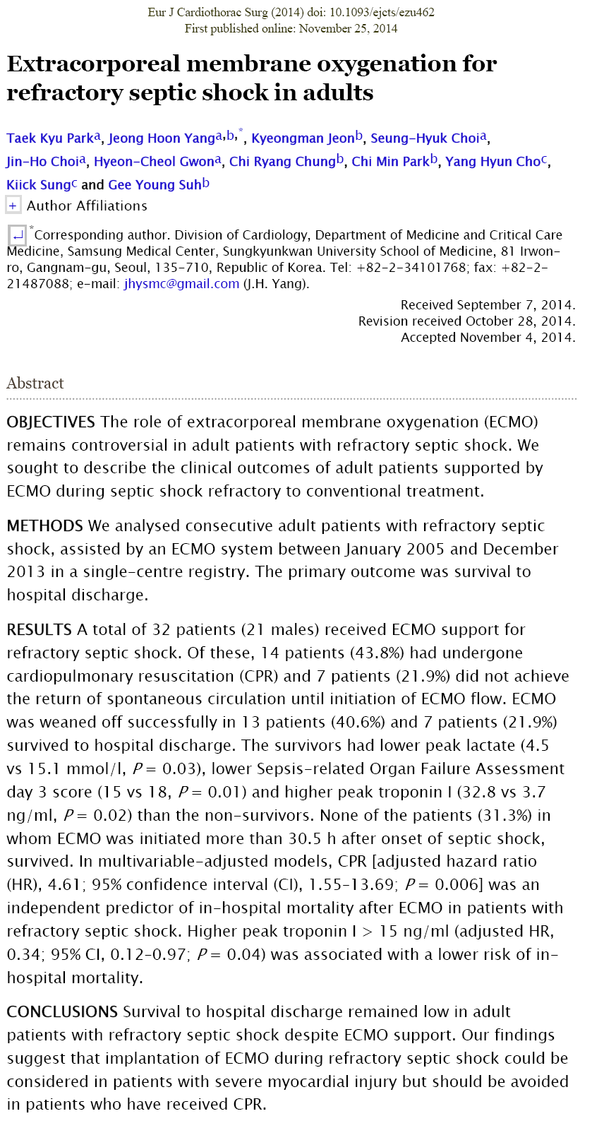
Jan 2005 to Dec 2013
N = 32, refractory septic shock, 7 patients survived
Univariate analysis: survivors had lower peak lactate, lower SOFA score at D3, higher peak TnI
Multivariate analysis: CPR was an independent predictor of in-hospital mortality; High peak TnI was associated with a lower risk
Park TK, et al. Eur J Cardiothorc Surg 2014

Slide 21
3. Technical aspects

Slide 22
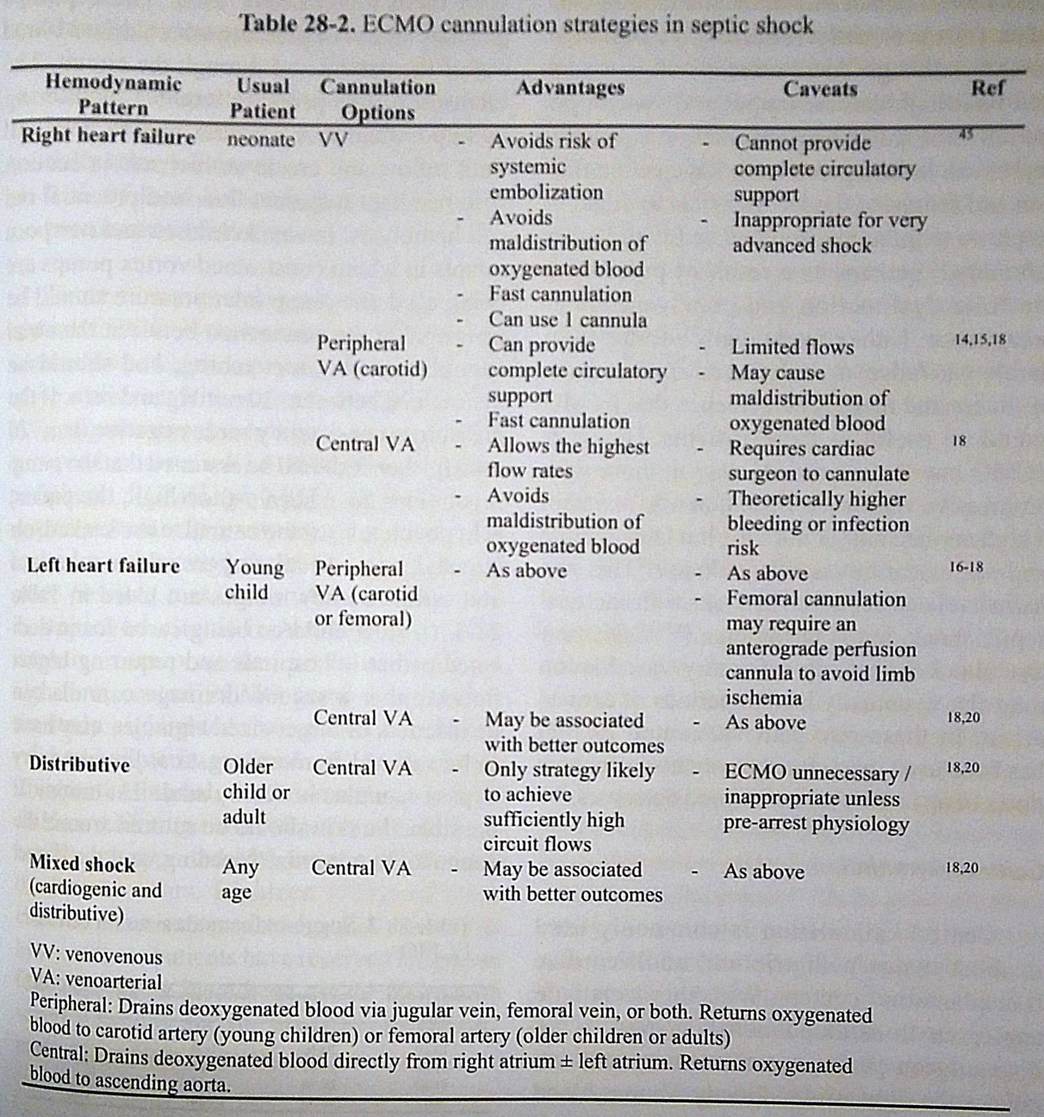
Low CO, High SVR more common
High CO, Low SVR more common initially, then progressing to mixed shock
Abnormalities at mitochondrial level of low oxygen extraction
Ref: ELSO. ECMO – Extracorporeal Cardiopulmonary Support in Critical Care, 4th Edition. 2012

Slide 23
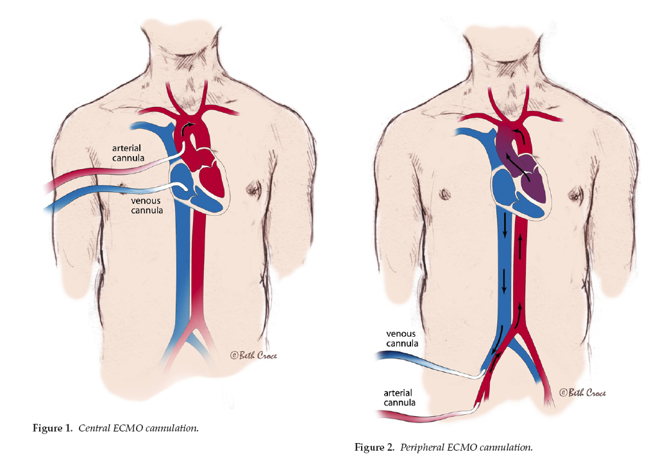
Central and Peripheral VA-ECMO
Marasco SF, et al. Heart, Lung & Circulation 2008

Slide 24
Suggested cannula sizes for central ECMO
Patient weight (kg) | Atrial Cannula (Fr) | Aortic Cannula (Fr) | Anticipated Flows (L/min)
<10 | 14 - 28 | 10 - 16 | 1 - 2
10 – 20 | 20 - 36 | 14 - 20 | 3 - 4
21 - 40 | 24 - 46 | 18 - 21 | 4 - 6
41 - 60 | 28 - 50 | 20 - 24 | 6 - 8
>60 | 36 - 52 | 22 - 24 | 8 - 10
Management goals: restore organ blood flow and adequate tissue oxygenation while awaiting recovery, without damage to the lungs or circulation = Normalization of lactate, SvO2>70%, age-appropriate MAP
Most patients on ECMO for septic shock recover with 3 – 4 days
In sepsis, flows required are mostly in the range of 150 – 200 ml/min (For a 60-kg person, = 9 to 12 L/min)
Flow associated with less hemolysis: <110 ml/min (For a 60-kg person, < 6.6 L/min)
MacLaren G, et al. Peadiatr CCM 2007
MacLaren G, et al. Pediaatr CCM 2011
MacLaren G, et al. CCM 2009

Slide 25
Experience of high flow central ECMO in paediatrics
Brierley J, et al. CCM 2009
  N = 45 children, Refractory septic shock
  Central ECMO: 73% survived; Peripheral ECMO: 38% survived
MacLaren G, et al. Pediatr Crit Care Med. 2011
  Central atrio-aortic ECMO
  Twenty-three refractory septic shock patients, median age: 6 yrs; weight: 20 kg, over a 9-yr period were included.)
  Eighteen (78%) patients survived to be decannulated off ECMO, and 17 (74%) children survived to hospital discharge.
  Author conclusion: Central ECMO seems to be associated with better survival than conventional ECMO and should be considered by clinicians as a viable strategy in children with refractory septic shock.
Royal Children’s Hospital, Australia: 25 septic shock children with central ECMO over 10 years, 72% survived to hospital discharge

Slide 26
4. Possible reasons to explain such outcomes

Slide 27
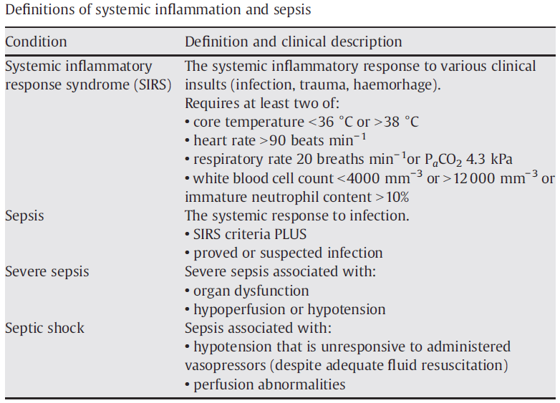
Definitions
Bone RC, et al. ACCP/SCCM Consensus Conference Committee, ACCP/SCCM. Chest 1992
ELSO registry 1987 – 1993: Sepsis was defined as
  the presence of pathogenic microorganisms or their toxins in the blood or other tissues. It may be diagnosed clinically by symptomatic evidence of infection, or by laboratory studies. It may also be diagnosed by a documented positive culture.
Many other definitions exist : e.g. shock in children is defined by prolonged capillary refill time of >2s or hypotension (PALS/APLS Guideline)

Slide 28
Comparison of sepsis in different age groups
 | Neonates | Pediatric | Adults
Etiology | Viral or bacterial Primary bacteremia commoner Most are reversible | most commonly secondary to viral or bacterial pneumonia +/- ARDS | Most commonly bacterial Viral +/- secondary bacterial
Comorbidity | Prematurity, congenital heart, chronic lung ds | Cancer, solid organ and HSCT, NMD | Old age, immunocompromised states, IHD, DM, HT, lipids, diastolic dysfunction, COPD, obesity
Pathogenesis of cardiac dysfunction | Lack of physiologic transition from fetal to neonatal circulation (persistent PHT, RV failure, TR, hepatomegaly) Immaturity of the myocaridial Ca regulation system Neonatal cardiomyocytes do not exhibit an increase in apoptosis despite an increase in TNFα production |  | Results from increased levels of TNFα and from increased cardiac myocyte production of nitric oxide and peroxynitrite, which leads to further DNA damage and ATP depletion, resulting in secondary energy failure.
Initial response to sepsis | Dec CO, SVR high (cold shock) Abnormalities in vasoregulation, Little inc in blood pressure or CO even fluid Need aggressive fluid/kg c/w adults VO2 mainly determined by DO2 (i.e. CO, Hb, SaO2, PaO2), but further tachycardia cannot inc SV or CO | Both warm and cold shock Low CO + High SVR (cold) 22% may have high CO + Low SVR (warm) | Initially mainly Low SVR + Dec EF but Normal or inc CO (by inc in HR and LV dilatation) (Warm shock) VO2 mainly determined by oxygen extraction, reduction of O2 delivery/utilization at mitochondrial level Death mainly due to MOF (commonest), progressive ventricular dilatation and cardiogenic shock (20% of patients), refractory vasodilatation (rare)
Beneficial Rx | Inotrope and vasodilators, NO, milrinone | vasodilators | vasoconstrictors
Mortality of sepsis | Early onset 40%, Late onset 20% | 10 – 20% | 35 – 50%

Slide 29
Pathophysiology in adult sepsis
Heart (PUMP SUPPLY SIDE)
  myocardial depression can occur even early in the course of sepsis (release of cytokines, some of which are associated with abnormal calcium handling by the cardiac myocytes). Profound but transient myocardial dysfunction in
    50% of patients with septic shock (Parker et al 1984)
    30 to 60% sepsis-associated myocardial dysfunction (Vieillard-Baron A et al 2008, Pulido JN 2012)
Peripheral circulation (PIPELINE):
  simultaneous tachycardia and reduced vascular tone, afterload is reduced, with fluid therapy – cardiac output can therefore be maintained or even increased
  Most common cause of death of septic shock patients was refractory vasoplegia, whereas low CO was reported in <20% of the dying patients (Parker et al 1987)
Tissues (RECEIVING END DEMAND SIDE)
  not necessarily using up oxygen delivered, because of mitochondrial failure
Parker et al. Ann Intern Med 1984
Vieillard-Baron A et al. CCM 2008
Pulido JN et al. Mayo Clin Proc 2012
Parker et al. CCM 1987

Slide 30
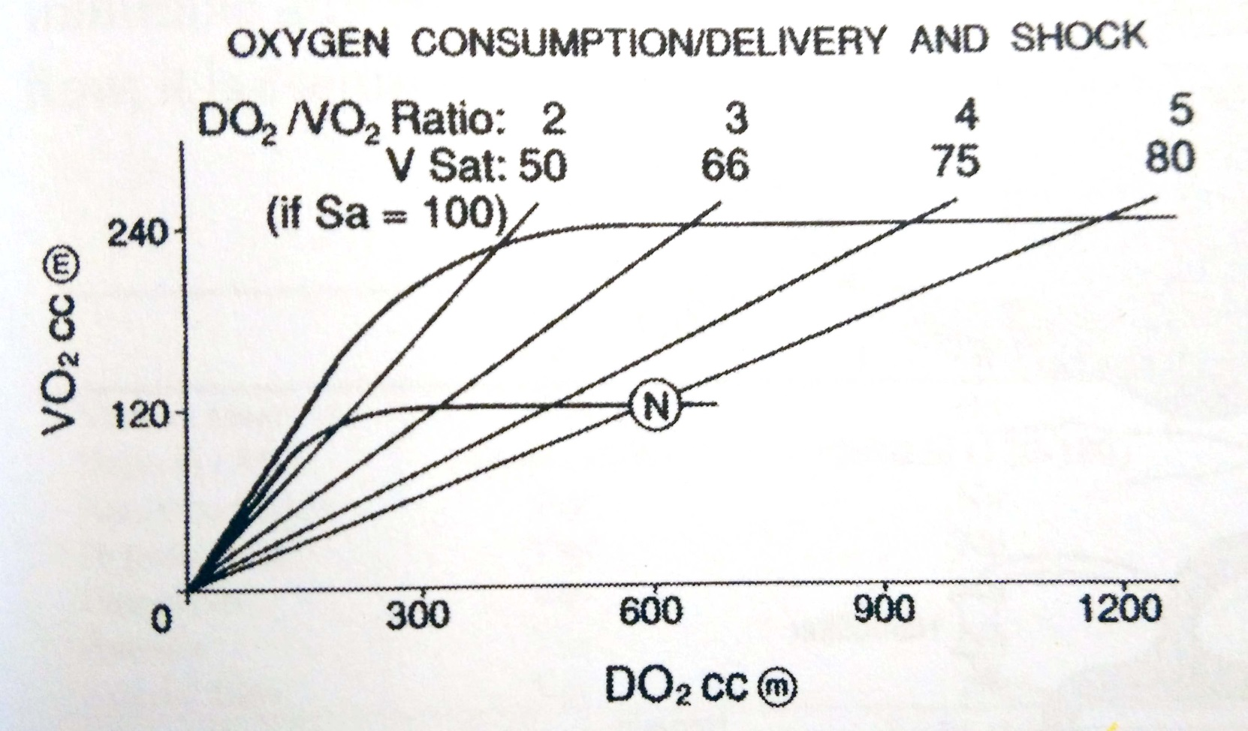
Relationships between oxygen consumption and delivery
ml/min/m²
Sepsis
SSyn
 | DO2 | VO2 | DO2/VO2
Normal | 600 | 120 | 5
Sepsis | 501 | 180 | 2.56
Sepsis syndrome | 515 | 156 | 3
Septic shock | 404 | 120 | 3.45
SShk
ml/min/m²
Graph from ELSO. ECMO – Extracorporeal Cardiopulmonary Support in Critical Care, 4th Edition. 2012
Numbers from Kreymann G1, et al. Crit Care Med. 1993

Slide 31
Authors | Results
Hayes MA, et al. Chest 1993 | VO2 in sepsis is no longer be DO2 dependent. Failure to increase VO2 was related predominantly to an inability of the tissues to extract or utilize oxygen rather than a failure to increase DO2
A trial of Goal-Oriented Hemodynamic Therapy in Critically Ill Patients (Gattiononi et al, NEJM 1995): | Supranormal CI and SvO2 do not reduce morbidity and mortality
Hayes AH et al. NEJM 1994 | The use of dobutamine to boost CI and systemic oxygen delivery failed to improve outcome in a heterogeneous group of critically ill patients … in some cases …. May have been detrimental
Hayes MA, et al 1997 | Nonsurvivors fail to increase VO2 following resuscitation, and when delivery is enhanced with aggressive inotropic support, oxygen extraction falls. (
Rivers et al. NEJM 2001 | ScvO2 guided EGDT (with measures to increase oxygen delievery, e.g. dobutamine, blood transfusion) improved outcome in severe sepsis and septic shock
PROCESS Investigators. NEJM 2014 | EGDT did not improve outcome
ANZICS ARISE Investigators. NEJM 2014 | EGDT did not reduce mortality in early septic shock
Sepsis is not only an oxygen delivery problem, amongst other mechanisms, failure of oxygen utilization has to be taken into account.

Slide 32
5. Conclusion and Future research directions

Slide 33
Conclusion
Neonates, c/w pediatrics and adults, fare better
Difference in sepsis pathophysiology in different ages, within same age group, and in different timing within an individual have to be considered.
Septic patients with predominantly cardiac dysfunction may benefit more, but less so in post-CPR cases and age > 60. The predominant reasons of death in adult sepsis are vasoplegia and mitochondrial failure leading to failure oof oxygen utilization.
High flow central ECMO may be needed in adults (faster resolution of shock, better distribution of oxygenated blood because from aorta, complete cardiac and pulmonary support)

Slide 34
Future research directions
ECMO particularly/only beneficial in this subgroup of pathophysiology: progressive ventricular dilatation and cardiogenic shock (20% of patients)? Not useful in MOF and relentless vasodilation group
Combining ECMO with other adjunctive Rx may be beneficial? – plasmapheresis, thrombomodulin, IVIg, plasma adsorption
ECMO flow required? High flow VV-A, or Central VA better?
Optimal level of anticoagulation in face of DIC
Oxygenator membrane and tubing colonization issues
How ECMO and other modalities affect vasculature and tissue level oxygen kinetics

Slide 35
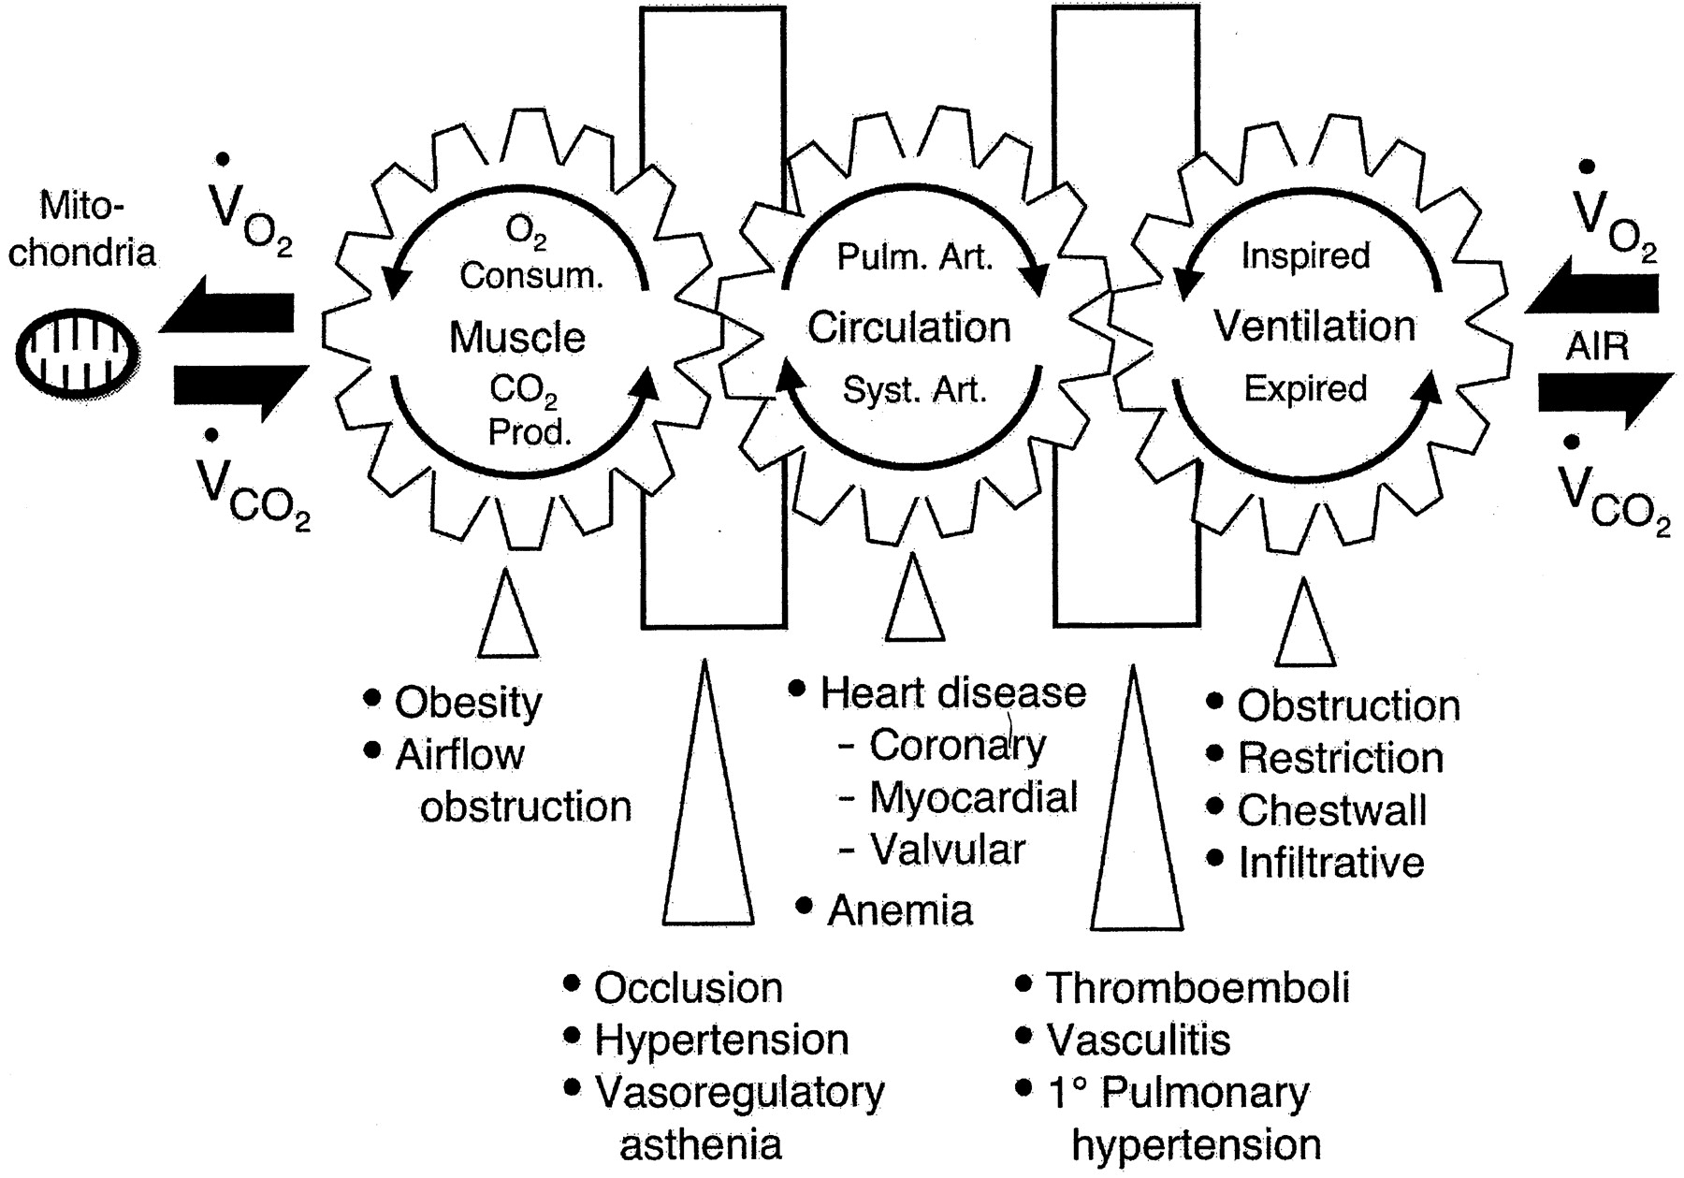
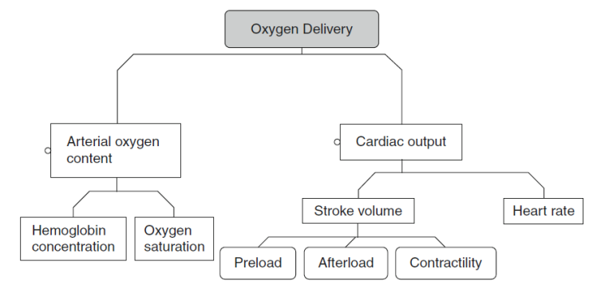
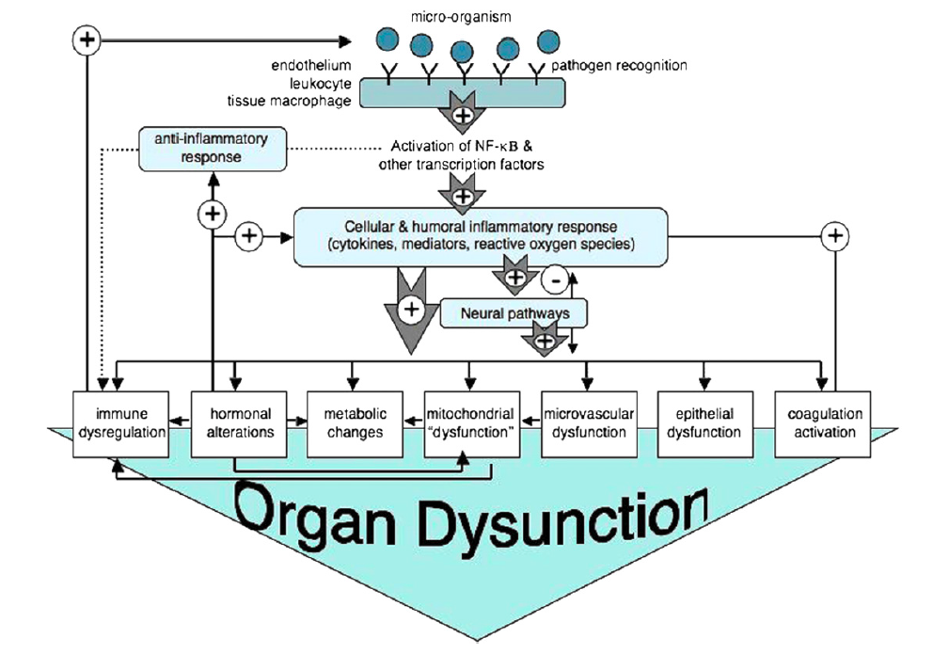
Future research directions
Any particularly pathophysiology pattern will particularly benefit?
Combining ECMO with other adjunctive Rx may be beneficial? – plasmapheresis, thrombomodulin, IVIg, plasma adsorption
ECMO flow required? Central VA necessarily better
Optimal level of anticoagulation in face of DIC
Oxygenator membrane and tubing colonization issues
How ECMO and other modalities affect vasculature and tissue level oxygen kinetics

Slide 36
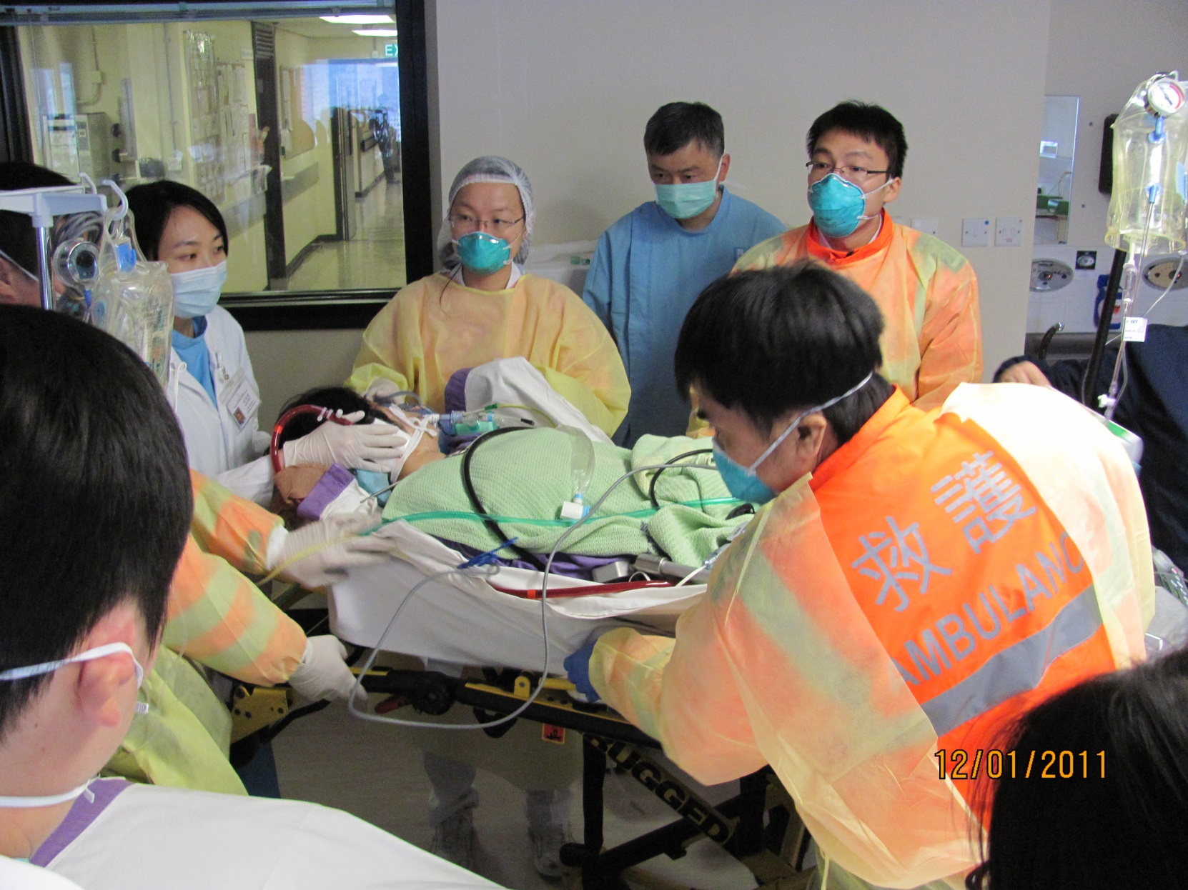
Every accomplishment began with a decision to try …
自古成功在嘗試
Thank you.

